Slide 1


Phishing Awareness: Don’t Get Hooked!
A Cyber Security Internship Project by Sai Tarun
Presented for: CodeAlpha Internship Program

Slide 2
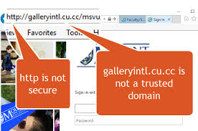
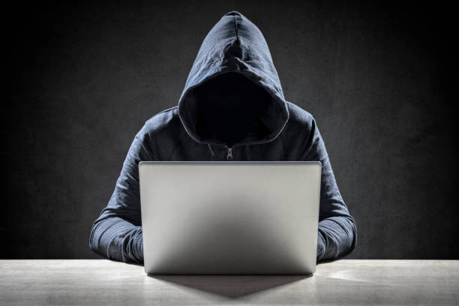
What is Phishing?
Phishing is a deceptive attempt to trick individuals into revealing personal or financial information through fake communication, often via email, SMS, or websites.
Mimics trusted brands or people.
Creates urgency or fear.
A leading cause of data breaches.

Slide 3
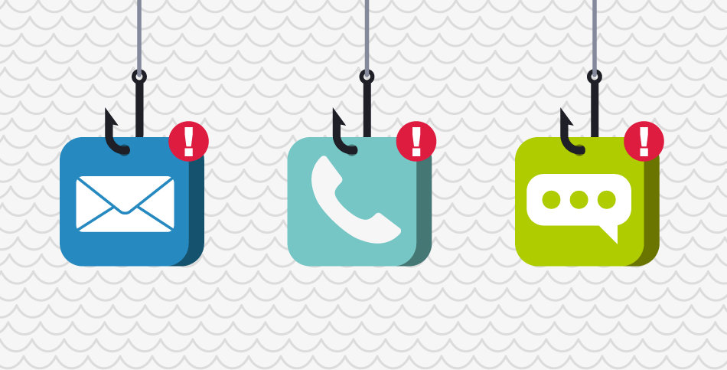
Types of Phishing Attacks
Email Phishing: Mass emails pretending to be from trusted services.
Spear Phishing: Personalized attacks on individuals.
Whaling: Targeting top executives.
Smishing: Phishing via SMS.
Vishing: Voice-based phishing (fake calls).

Slide 4
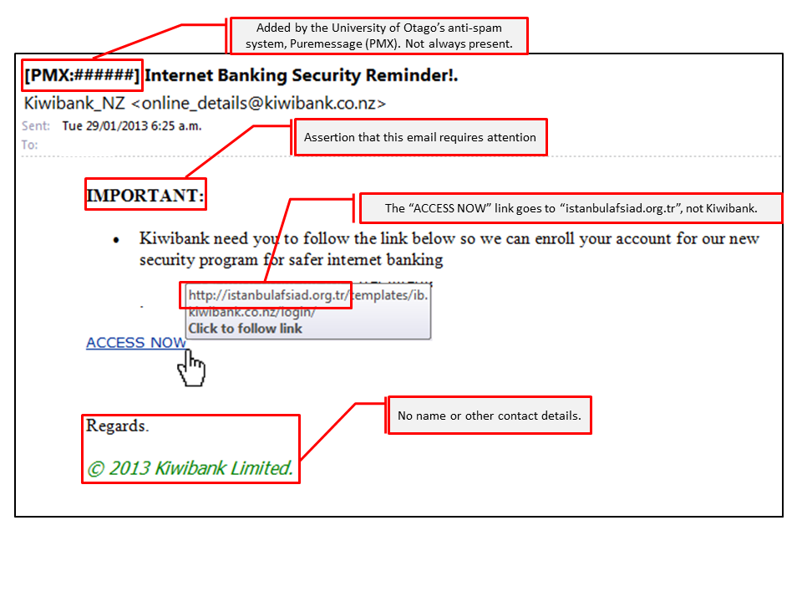
How to Recognize Phishing
❌ Suspicious sender address (e.g., support@paypa1.com)
❌ Spelling and grammar mistakes
❌ Generic greetings like “Dear User” or “Valued Customer”
❌ Links that don’t match the real site (hover to check!)
❌ Urgent threats like “Account will be blocked in 24 hrs!”
❌ Unexpected attachments or pop-ups

Slide 5
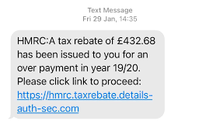
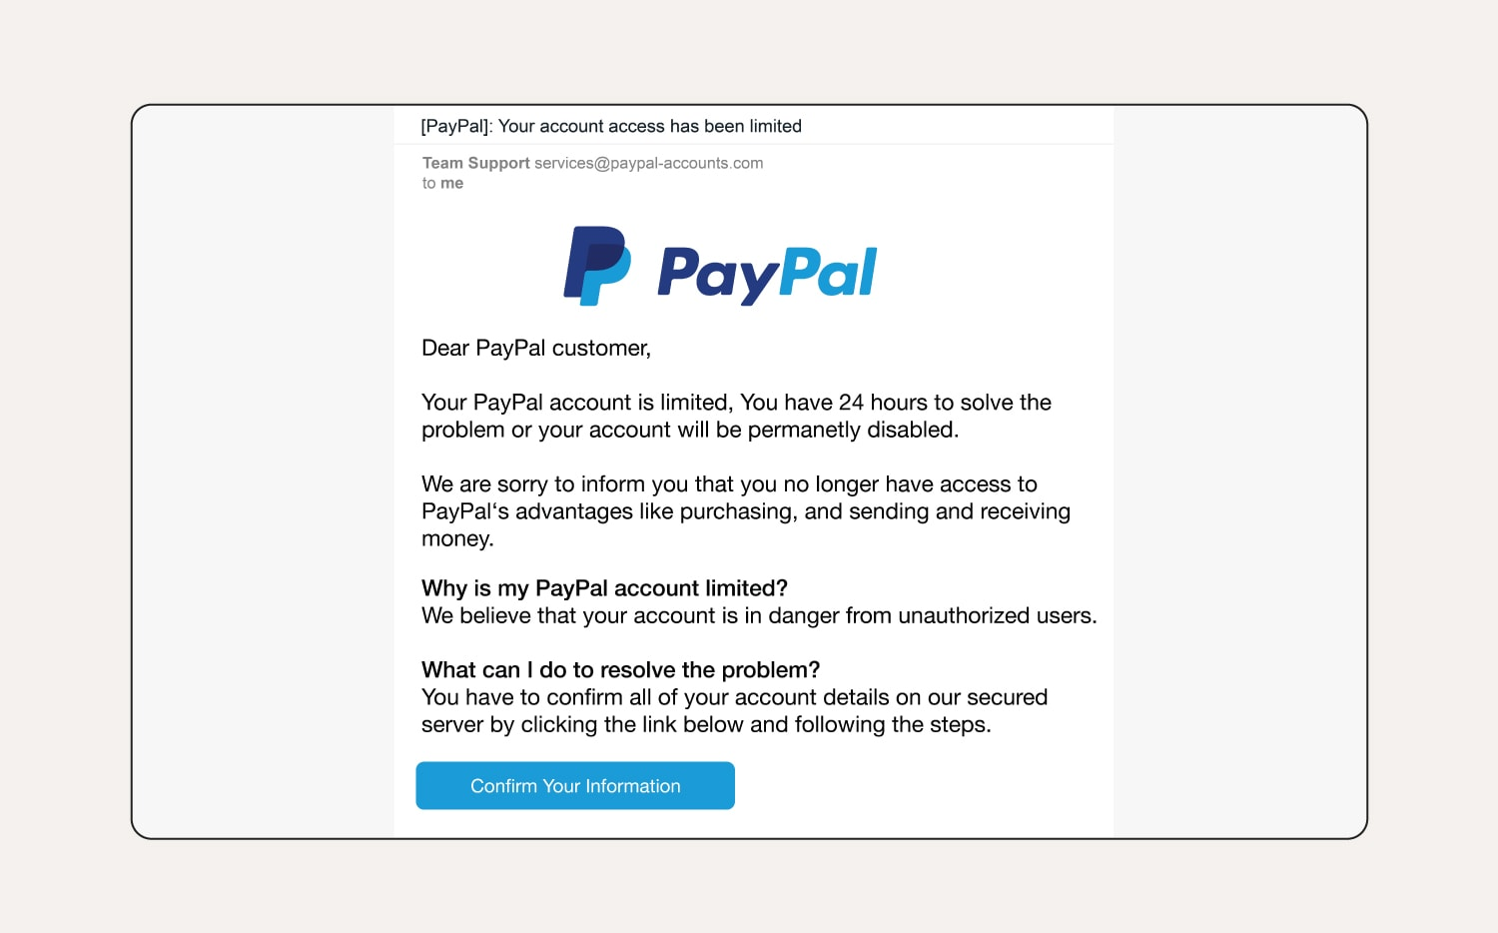
Real-World Examples
A fake PayPal email with “Click here to secure your account”.
A cloned bank login page.
A fake job offer email.

Slide 6
Quiz - Test Your Awareness!
Q1: What is a common sign of a phishing email? A) Uses personal greeting B) Contains urgent threats C) Comes from your manager
01
Q2: What should you do if you receive a suspicious email? A) Open and inspect it B) Click the link to check C) Report or delete it
02
Q3: What is “vishing”? A) Voice phishing B) SMS phishing C) Email with viruses
03
Answers:
Q1 : B
Q2 : C
Q3 : A

Slide 7
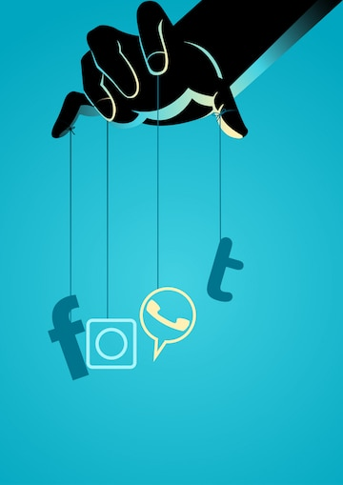
Social Engineering Tactics
Phishing works by manipulating human behavior, not just technology.
Common tactics:
Fear/Urgency: "Account blocked!"
Reward: "You’ve won a voucher!"
Authority: "From your bank CEO"
Curiosity: "See who viewed your profile"

Slide 8

Best Practices to Avoid Phishing
Type URLs manually
Enable 2-Factor Authentication
Don’t open unknown attachments
Always verify sender
Report phishing attempts

Slide 9
Tools to Detect Phishing
Top Tools:
PhishTank – Real-time phishing database
VirusTotal – Scans URLs/files
Google Safe Browsing
WOT (Web of Trust)
Gmail/Outlook Spam Filters

Slide 10

Conclusion
Stay informed, stay cautious.
Think before you click!
Share knowledge with your friends/family.
Report phishing emails to protect your organization.
“Awareness is the first step in cybersecurity.”

Slide 11

References
Content:
https://www.phishing.org
https://www.cyber.gov.au
https://www.consumer.ftc.gov
Microsoft Security Intelligence Reports
Proofpoint 2023 Phishing Report

